Slide 1


Slide 2
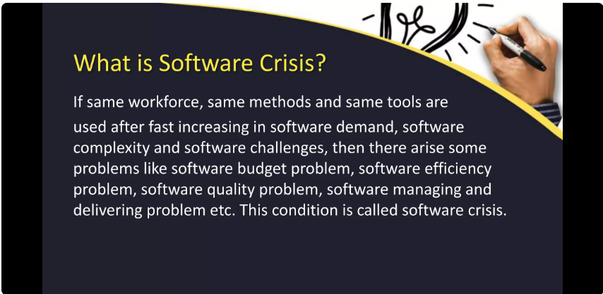

Slide 3
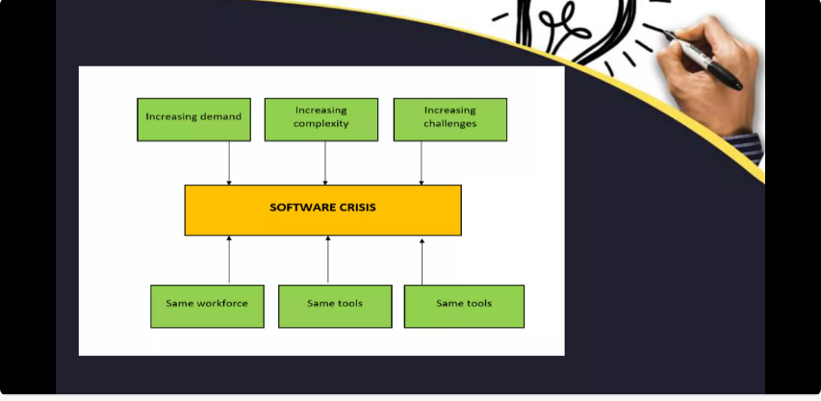

Slide 4
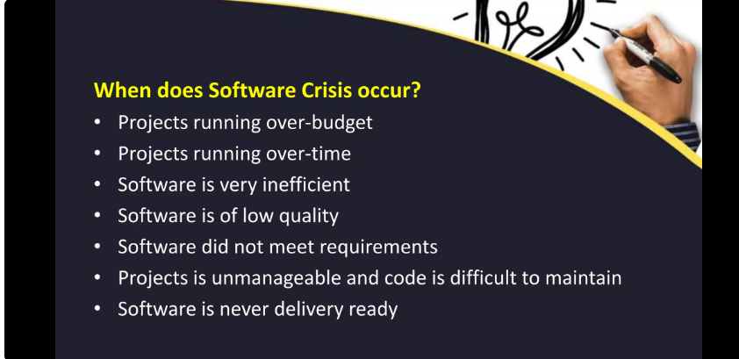

Slide 5
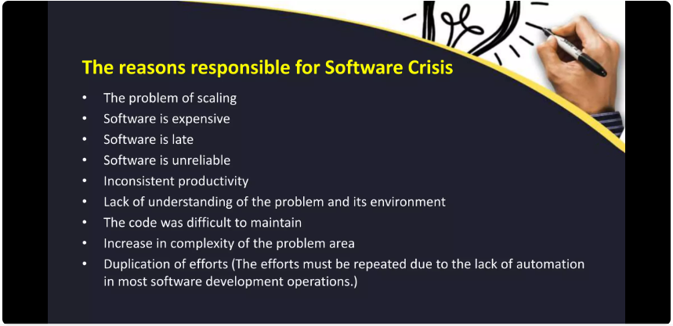

Slide 6
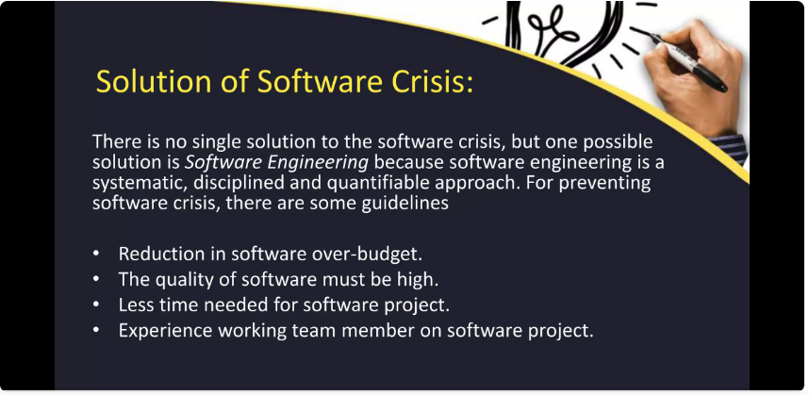

Slide 7
The 4P's in software engineering are fundamental aspects of software development that must be considered in order to create a successful software product. Here is a more detailed explanation of each of the 4P's:
Process: This refers to the software development methodology or framework used to guide the development of a software product. A software development process is a set of activities and tasks that are performed in a structured and organized manner. Examples of software development processes include Agile, Waterfall, DevOps, etc. The choice of development process will impact the way in which the software is developed, the roles and responsibilities of the development team, and the overall quality and success of the software product.
People: This refers to the individuals involved in the development of a software product. A software development project typically involves a team of people with different roles and responsibilities, such as software developers, project managers, product owners, stakeholders, etc. The success of a software development project is heavily dependent on the people involved and their ability to work together effectively.

Slide 8
Product: This refers to the software product being developed. The product is the end result of the software development effort and is what the end-user interacts with. A software product must meet certain requirements and quality criteria in order to be successful. This includes functional requirements, such as what the software should do, and non-functional requirements, such as performance, security, and usability.
Project: This refers to the specific software development effort, including its scope, schedule, and budget. The project encompasses the entire software development process, from initiation to deployment and maintenance. A software development project must be managed effectively in order to ensure that it stays within scope, is delivered on time and within budget, and meets the quality criteria set for the product. Project management practices such as risk management, change management, and stakeholder management are essential for the success of a software development project.

